Slide 1

Currency Note detection for Blind Assistance using DL Fyp-11 Presentation Computer Science Batch 4 Govt Ank Degree College Haripur Presented By M.Adil Saeed (CS 21406) | Maalik Ashtar (CS 21418)

Slide 2
Table of Content:
Introduction
Problem Statement
Objectives
Development
Future Work
System Architecture

Slide 3
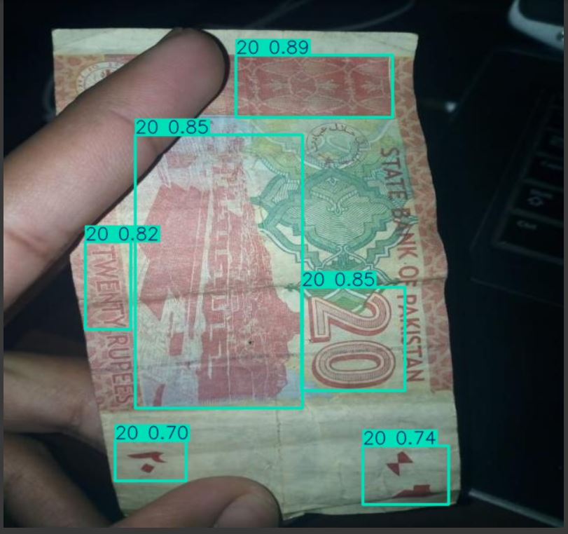
Introduction
In our project, we leverage the power of YOLOv5, a state-of-the-art object detection model, to accurately identify the Pakistani currency note. By training the model on a custom dataset of currency images, this system aims to provide a fast, reliable, and scalable solution for recognizing notes.

Slide 4
Problem Statement
Manual currency detection is difficult for blind people.
Existing systems struggle with real-time accuracy in different conditions.
Most systems lack offline voice control and audio feedback for blind users.
Need for a fast, scalable solution.

Slide 5
Objectives
To detect different currency notes accurately.
To offer an instant text-to-speech (TTS) output that announces the value of the detected currency.
To ensure functionality for users without the need for capturing images.
To provide a user-friendly interface that facilitates quick access to currency identification features.

Slide 6
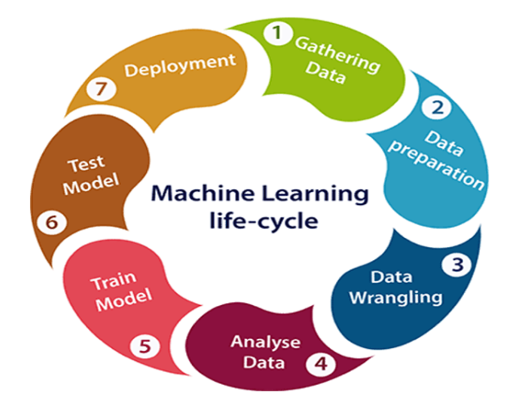
Development Methodology
The Machine Learning Development Life Cycle (MLDLC) is a structured process for developing machine learning & Deep learning projects, starting with defining the problem and collecting relevant data. The data is then cleaned, explored, and split into training, validation, and test sets. Model selection and training follow, where different algorithms are evaluated, and the best model is tuned through hyperparameter optimization.

Slide 7

Development Tools
YOLOv5
Python
Google Colab pro
Roboflow
Text to Speech Engine
Visual Studio Code
Vosk(Speech Recognition Tool)

Slide 8
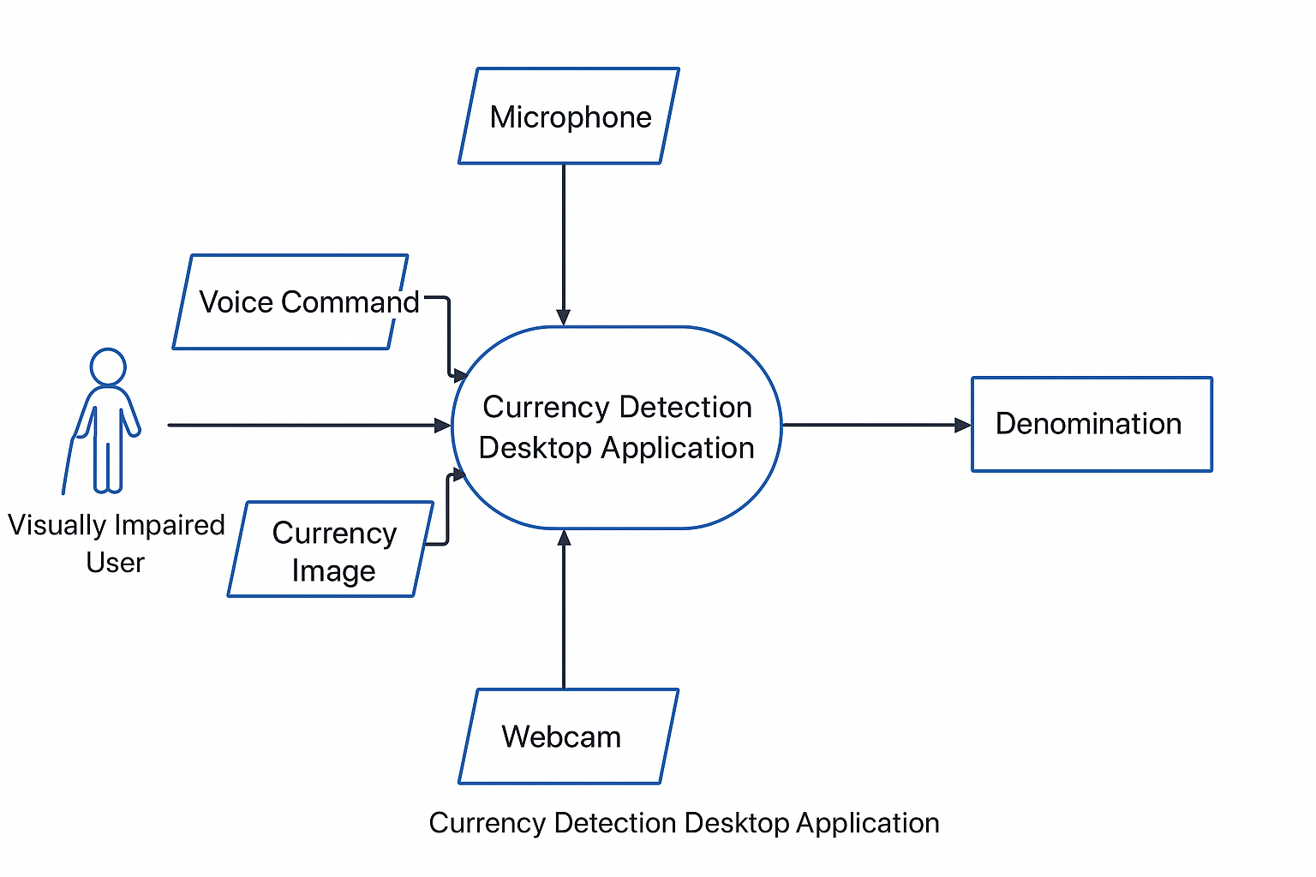
System Architecture
Use case diagram

Slide 9
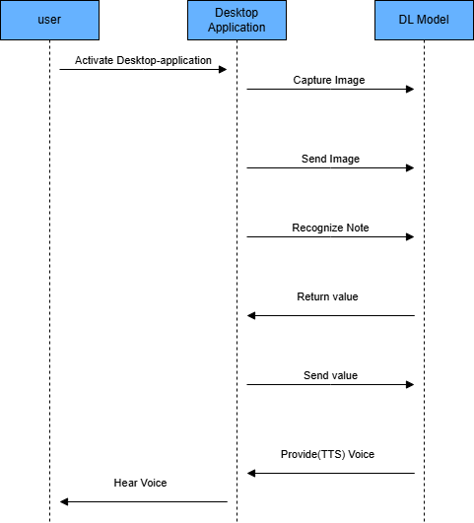
Sequence Diagram

Slide 10
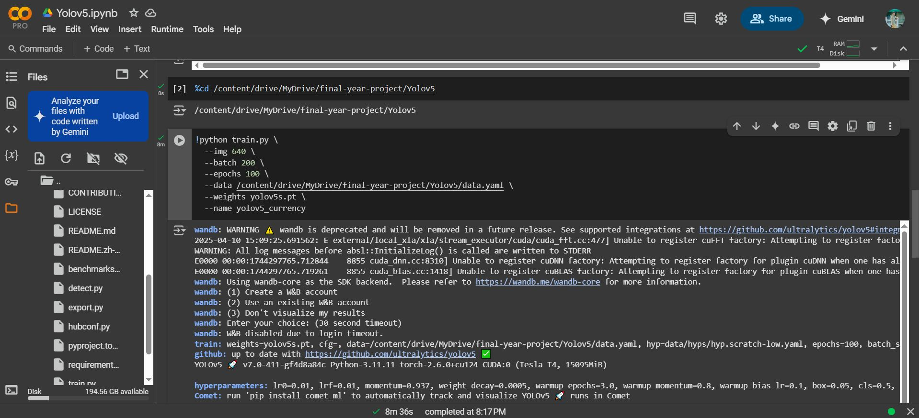
Training yolov5 Model

Slide 11
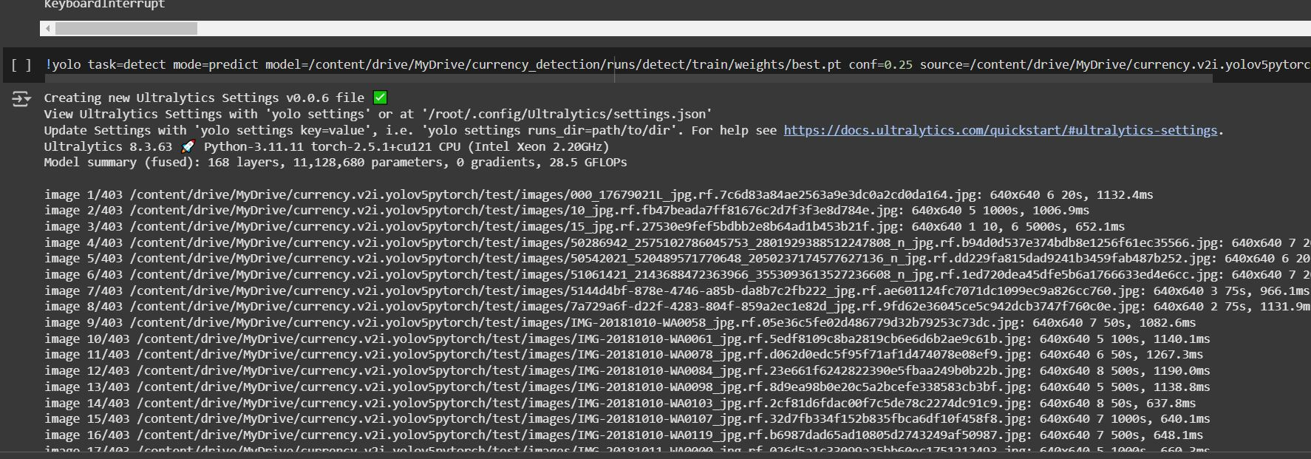
Testing the model

Slide 12
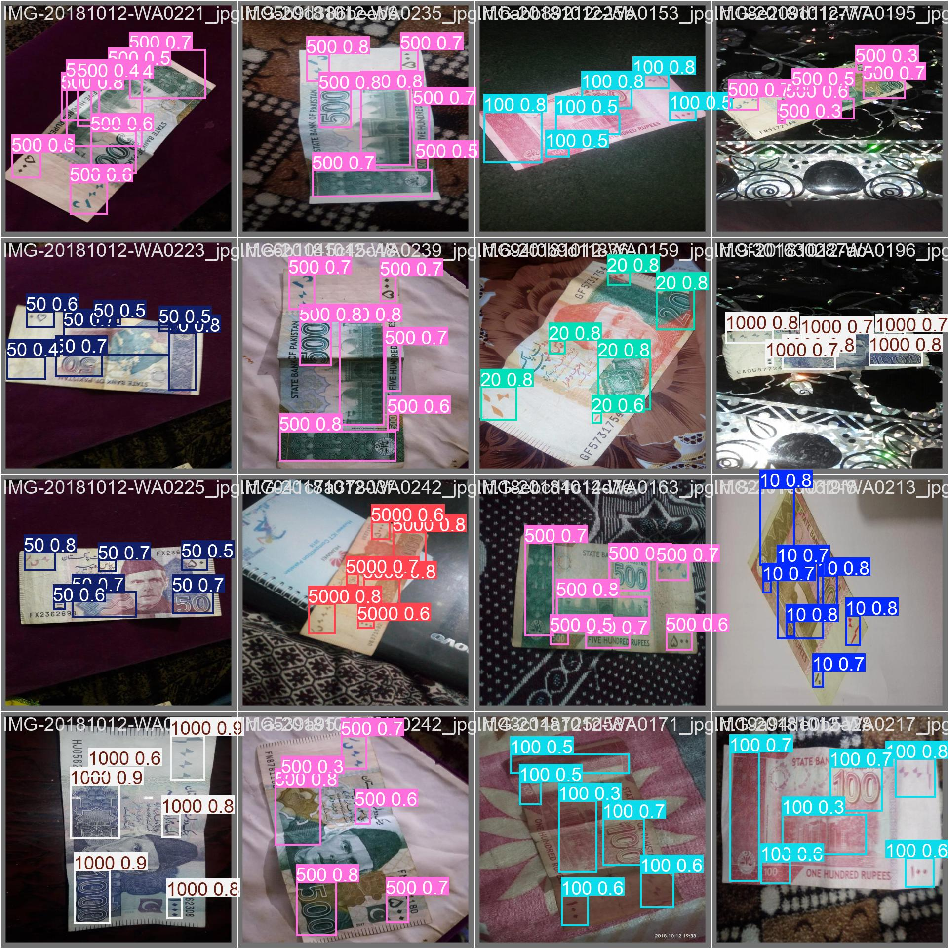

Slide 13
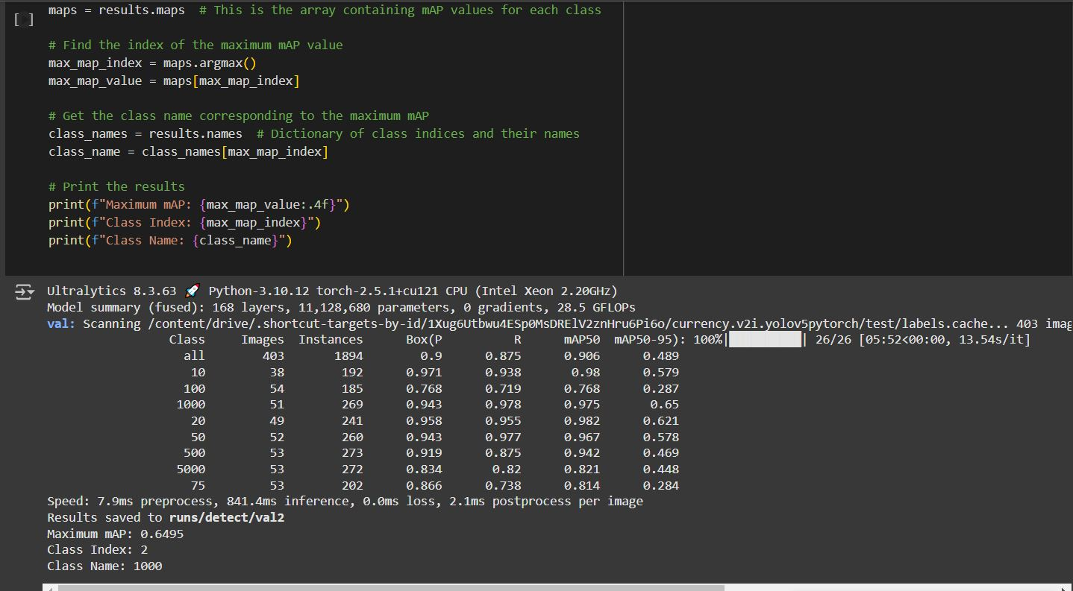
Accuracy of model

Slide 14
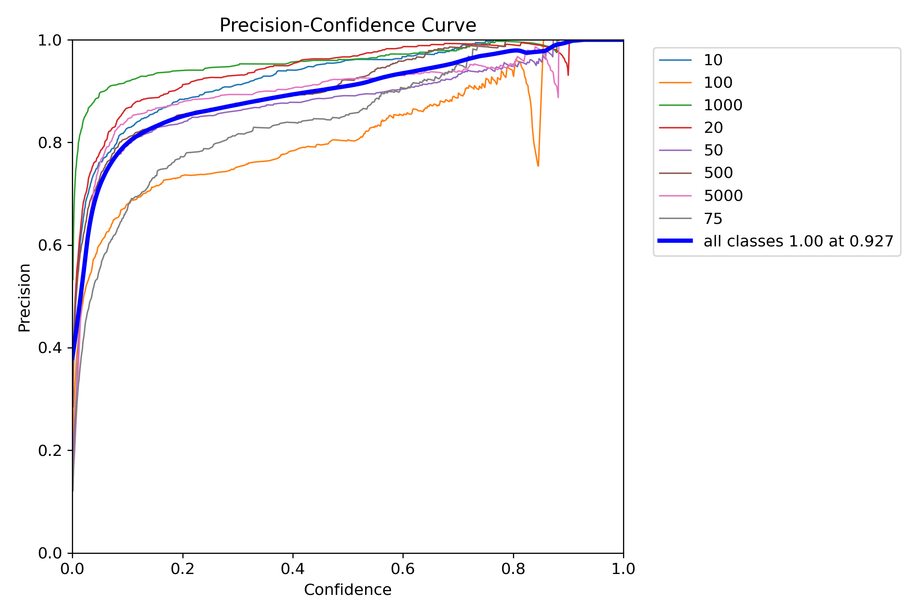

Slide 15
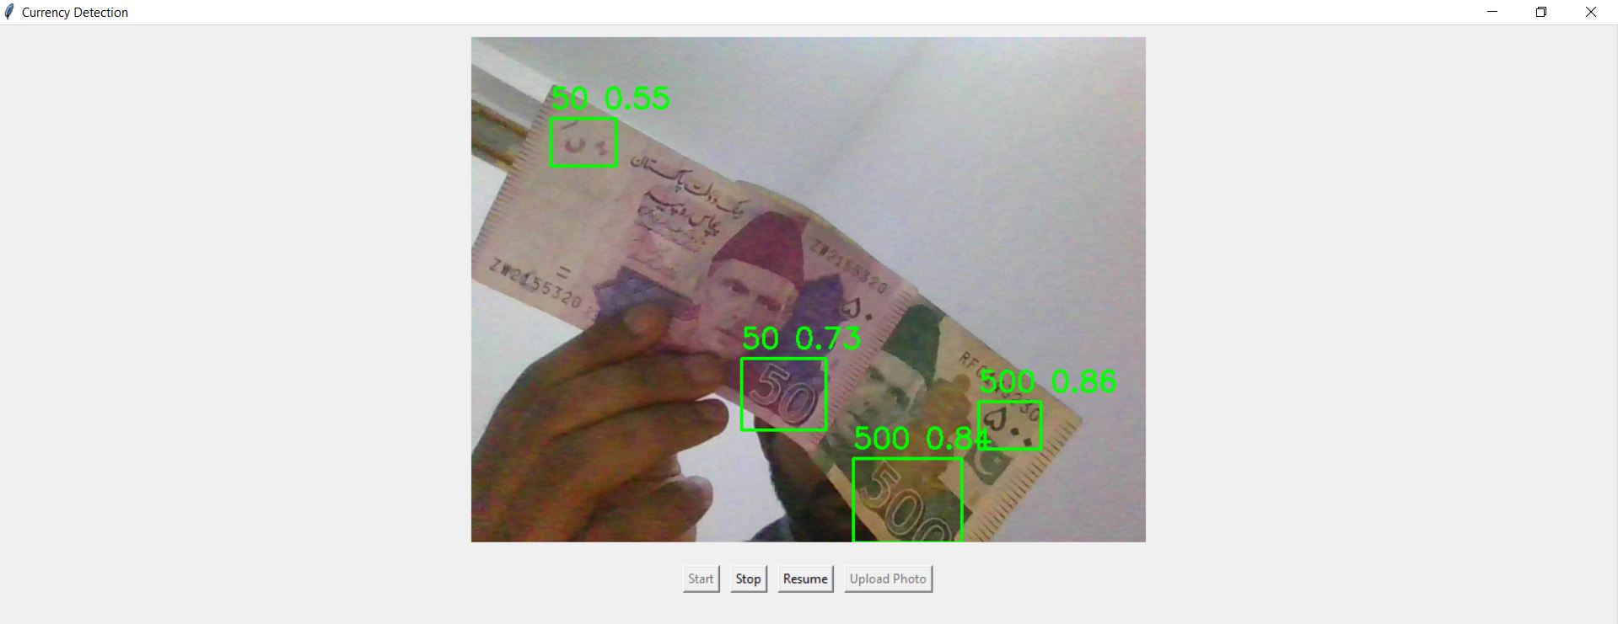
Testing model on random image

Slide 16
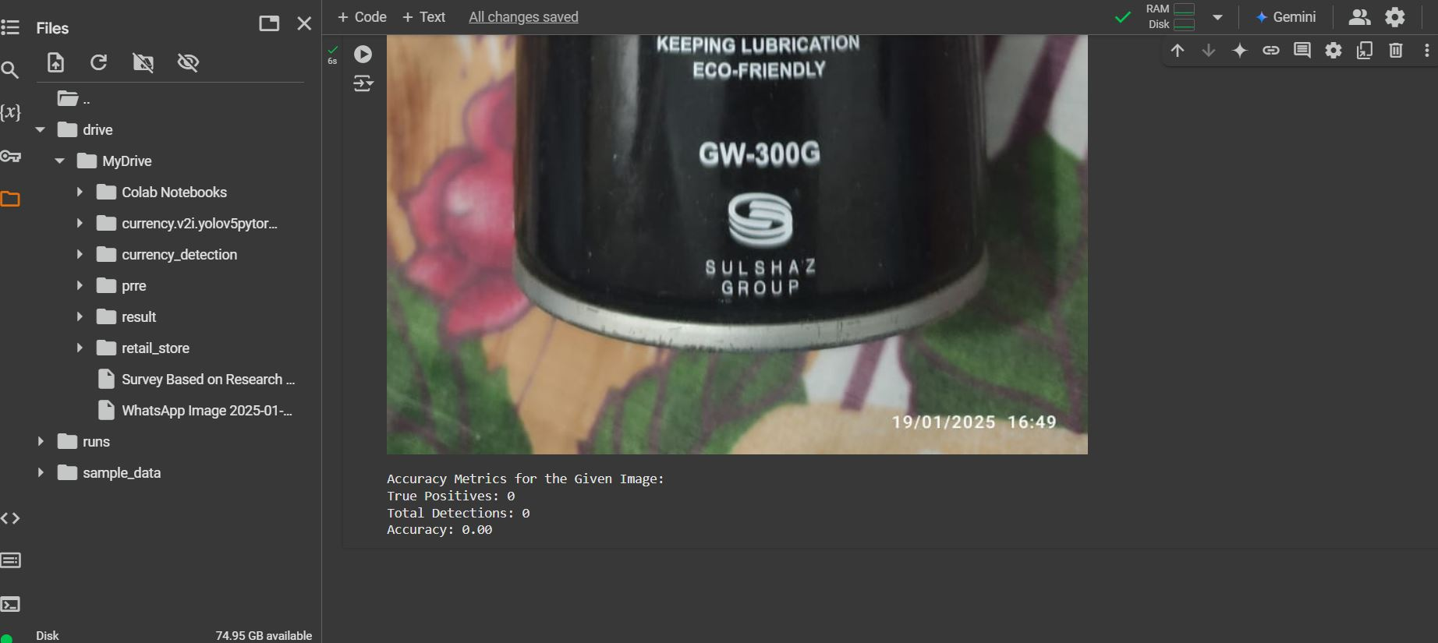
Testing model on random image

Slide 17
Future work
This project has great potential for future enhancements and the incorporation of additional features. One possible extension is the capability to detect currency coins in addition to banknotes, including any newly issued currency. Another promising direction is to develop a cross-platform version of the application compatible with iOS & android devices, thereby increasing accessibility and expanding the user base.

Slide 18
Thanks

